Slide 1

HOW JESUS SAVES US
THE GOSPEL ACCORDING TO PSALM 22

Slide 2
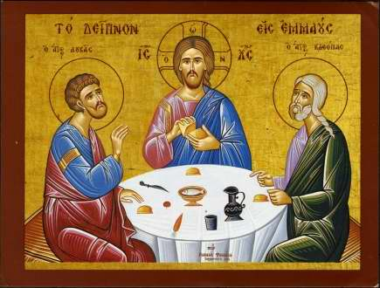
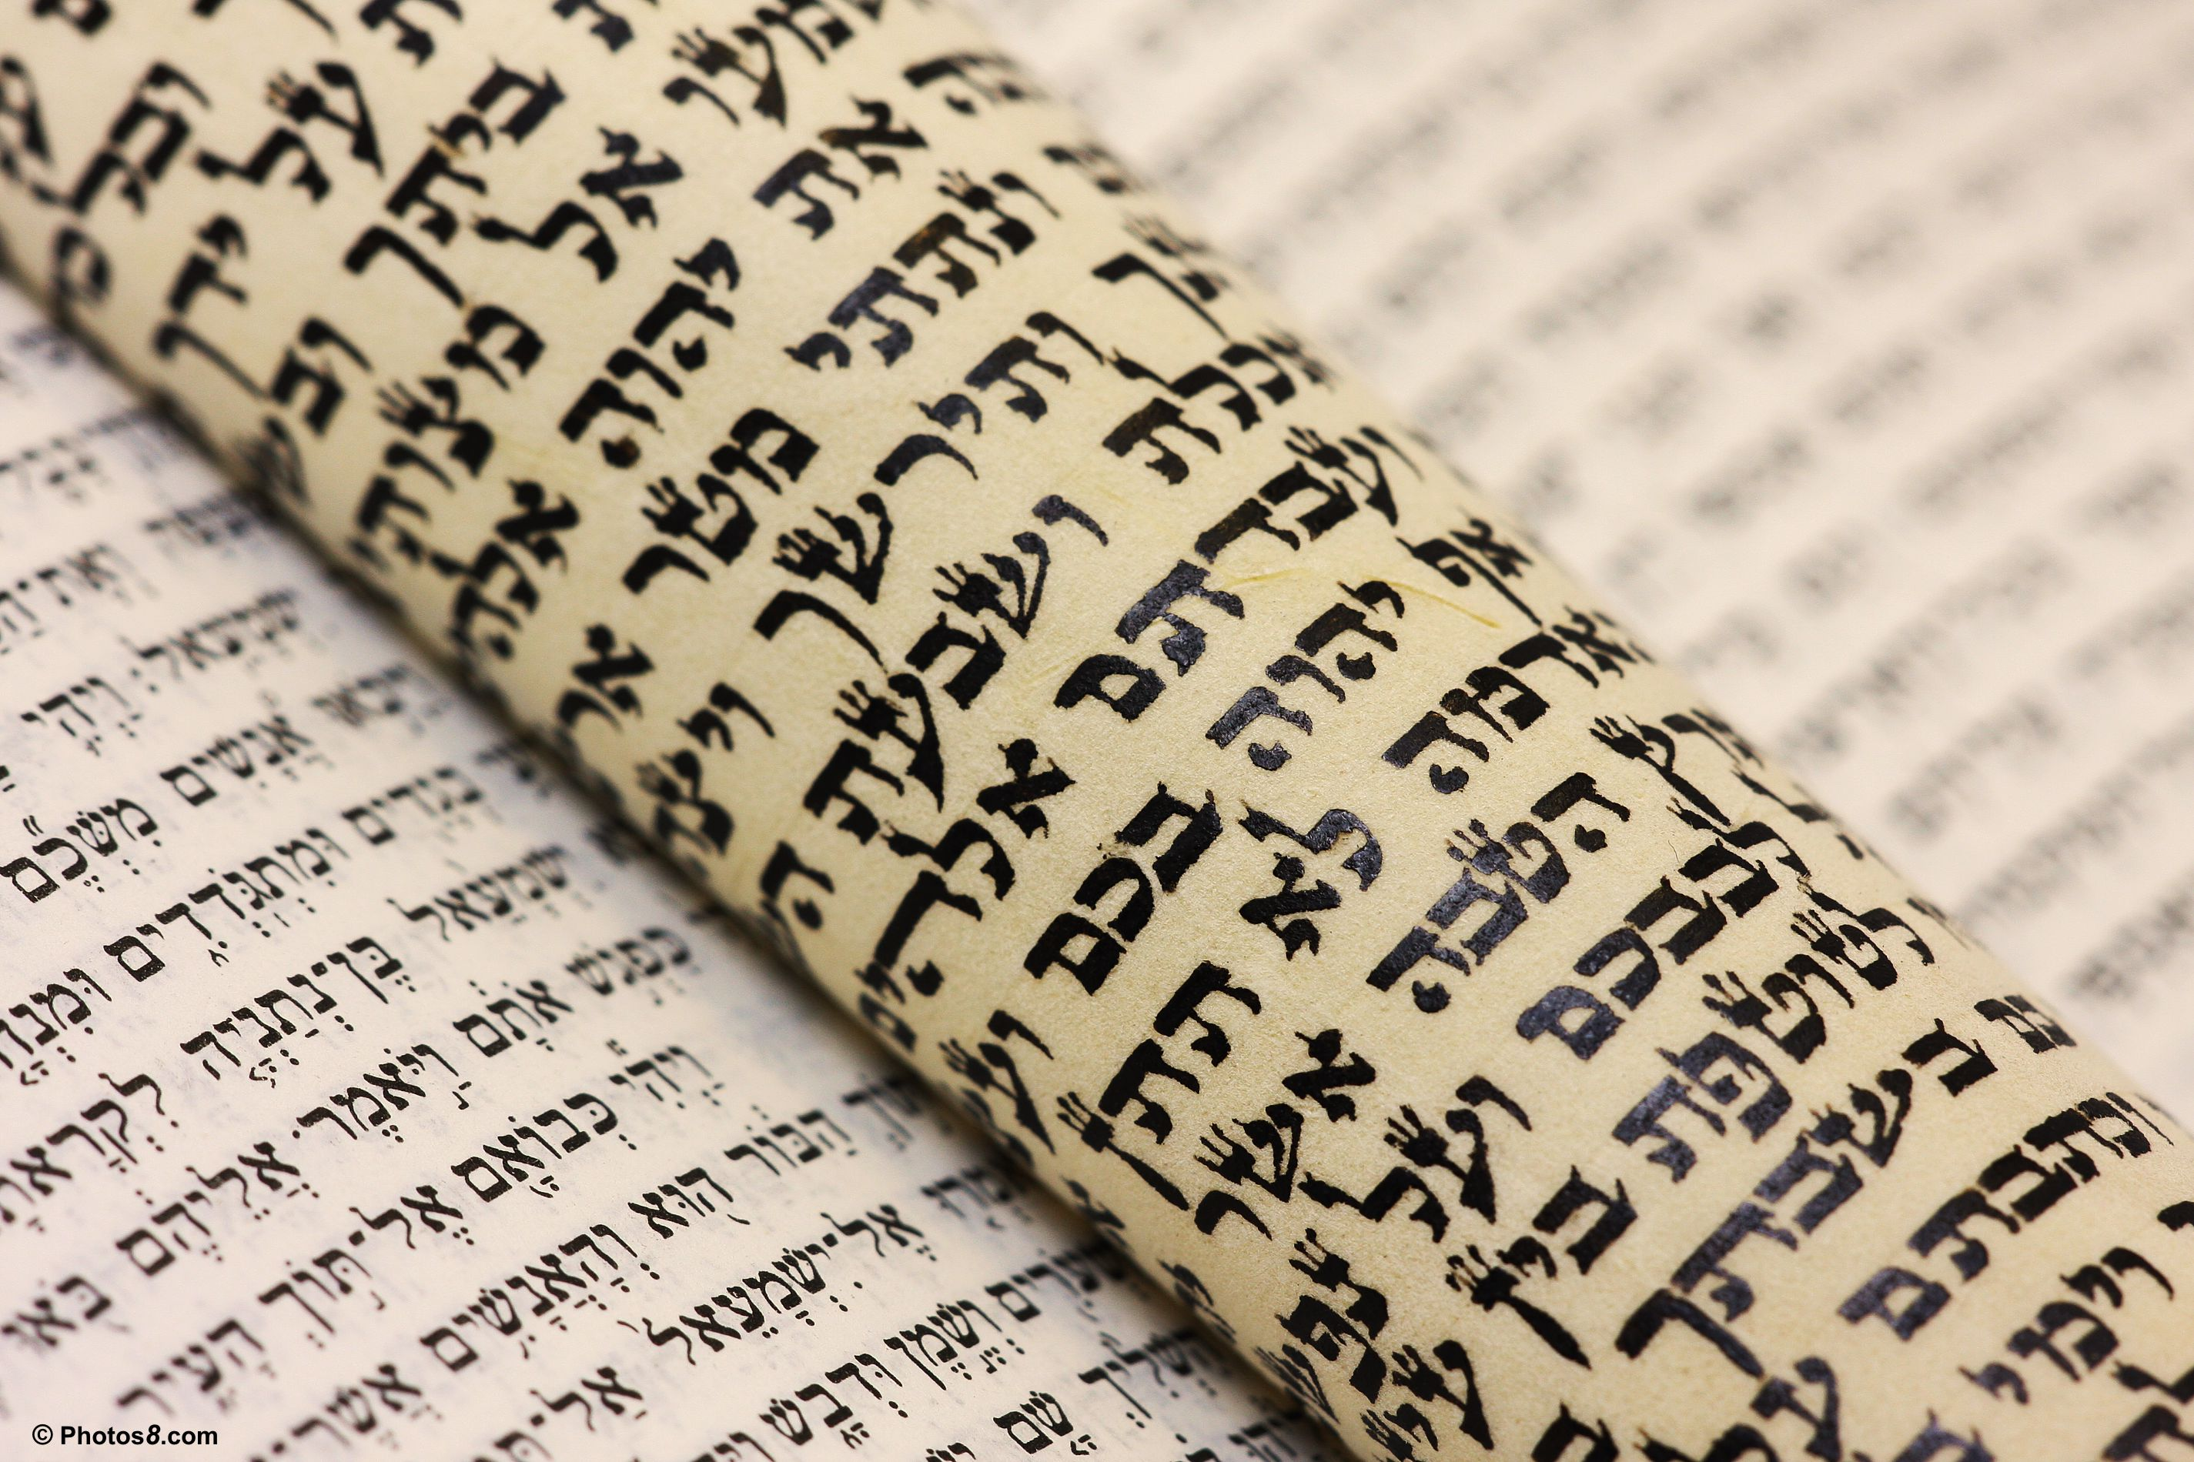
Where Jesus takes despondent disciples

Slide 3
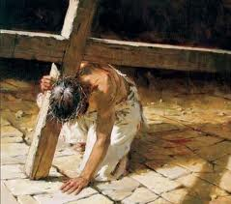

Slide 4


Slide 5
PSALM 22: HOW JESUS SAVES US

Slide 6
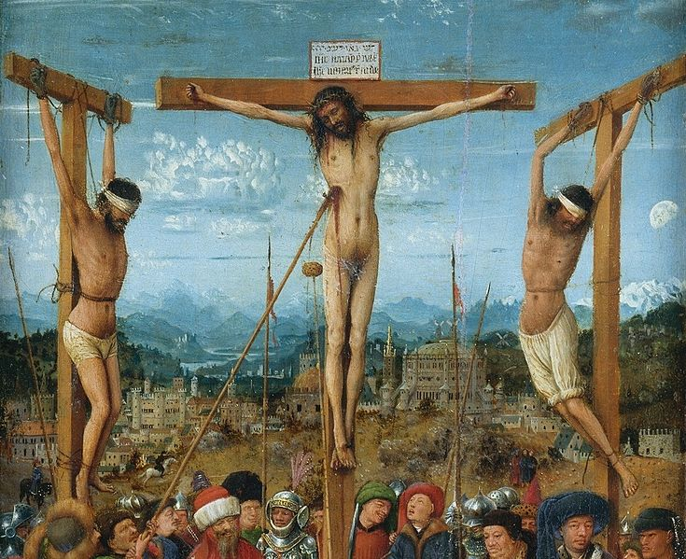
1) BY TAKING OUR ESTRANGEMENT FROM GOD UPON HIMSELF

Slide 7
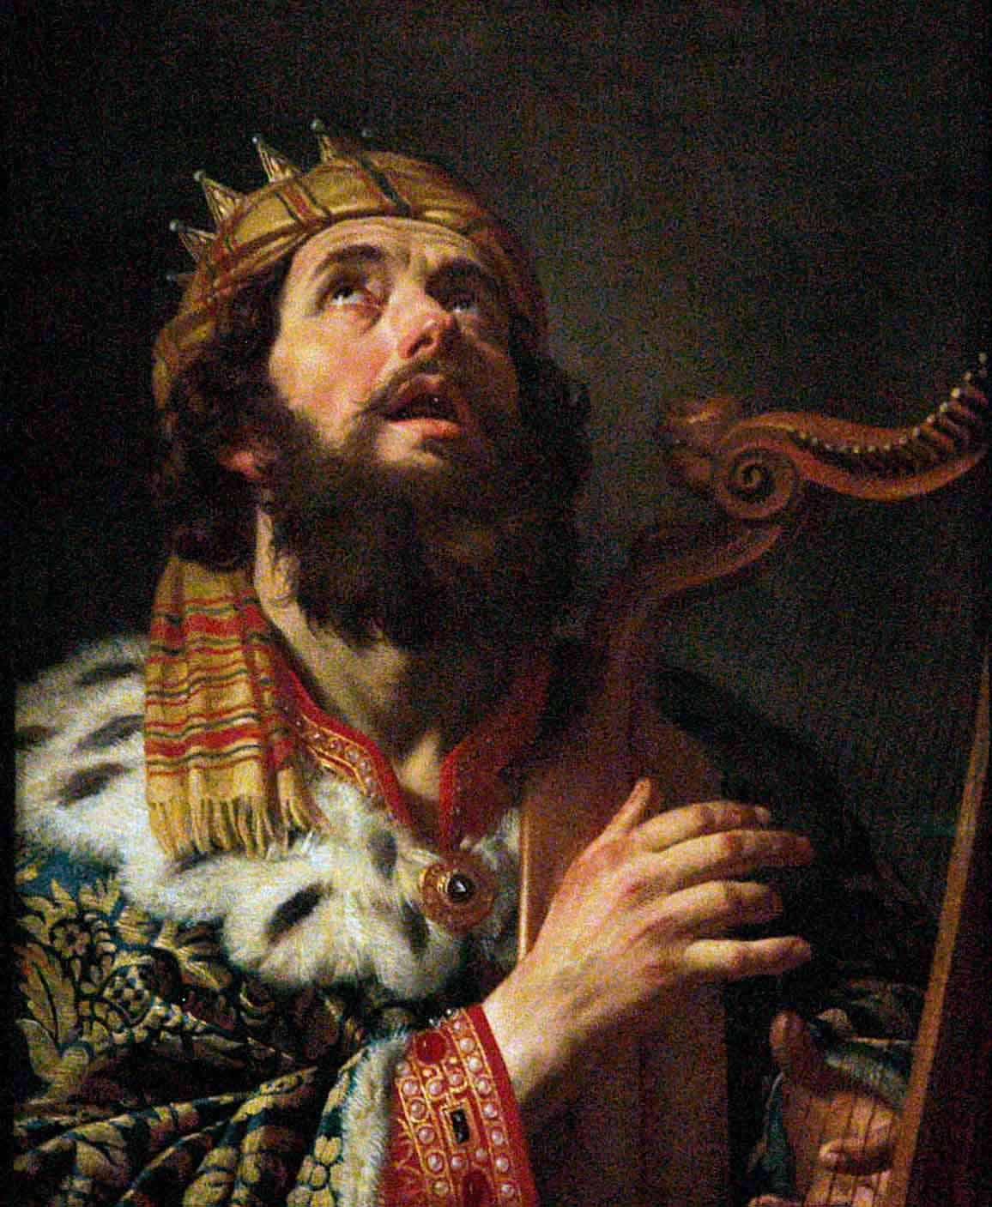
2) BY LIFTING HIS VEXATION TO GOD

Slide 8


Slide 9

3) BY HOLDING ONTO THE TRUTH

Slide 10

4) BY RAISING OUR GAZE

Slide 11


