Slide 1
Blessed to be a blessing
Alan McWilliam
Whiteinch Church of Scotland, Glasgow
alan@whiteinchchurch.org

Slide 2
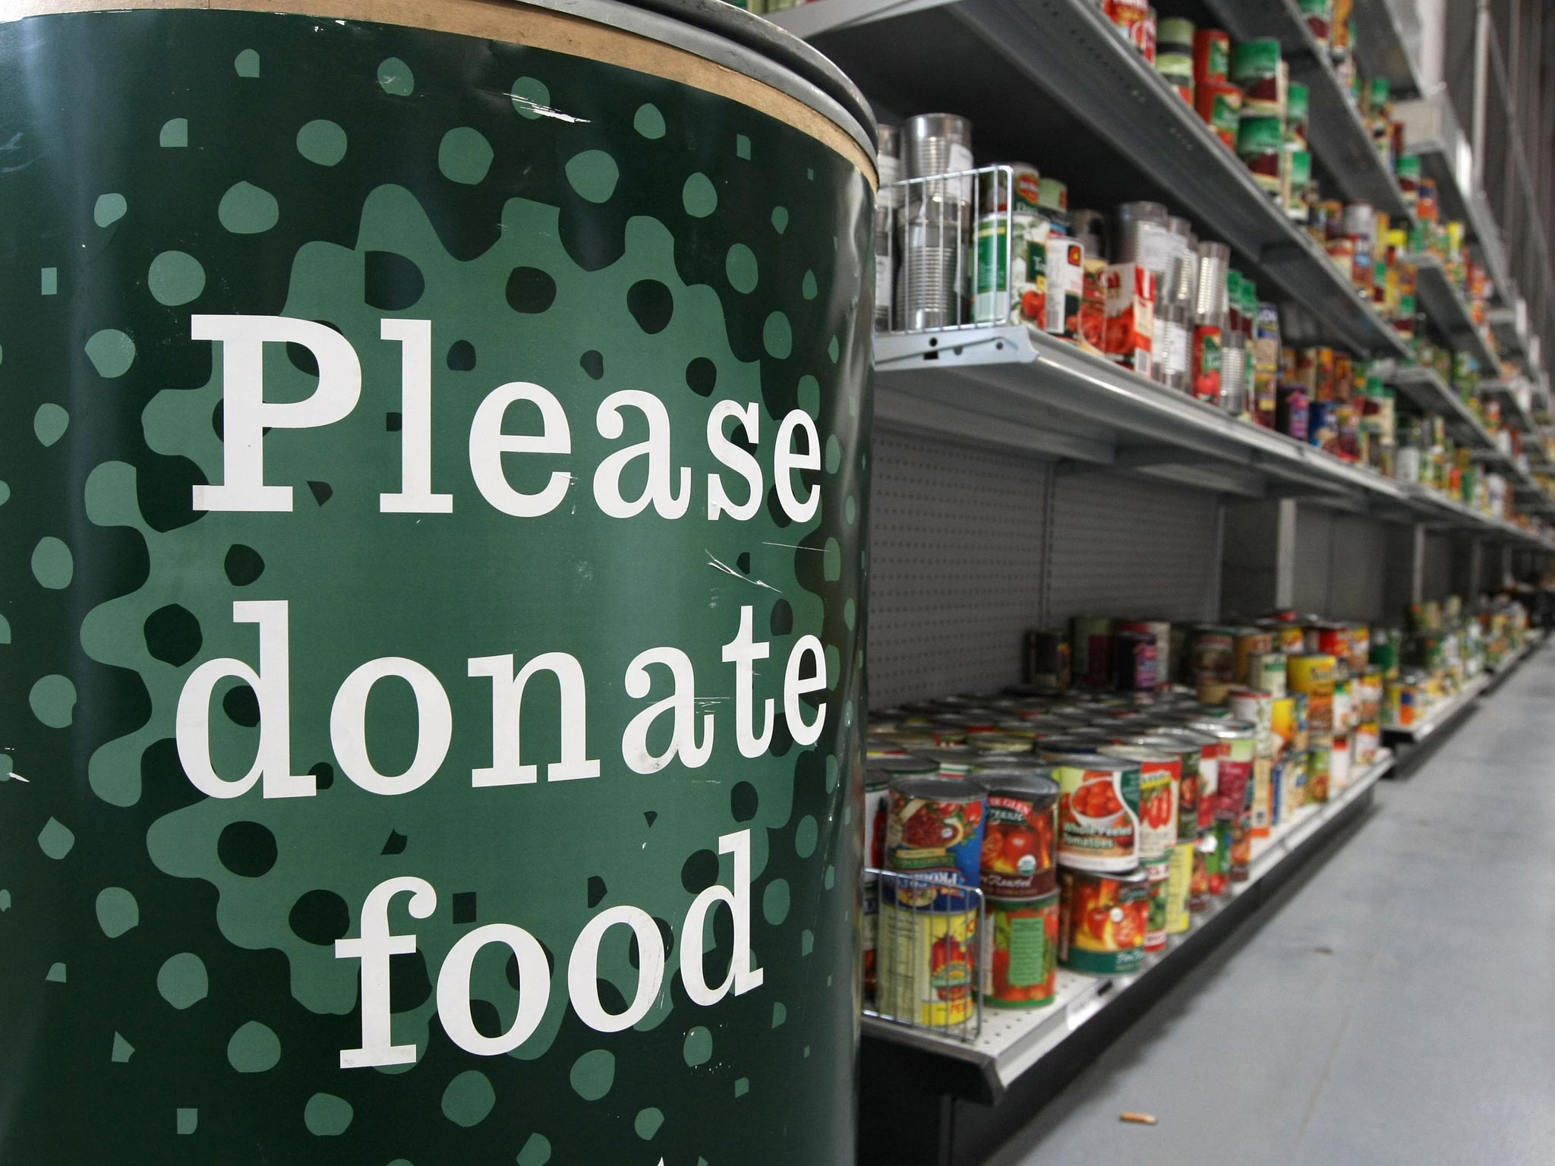
Anna

Slide 3
God’s Love and Ours
Dear friends, let us love one another, for love comes from God. Everyone who loves has been born of God and knows God. ⁸ Whoever does not love does not know God, because God is love. ⁹ This is how God showed his love among us: He sent his one and only Son into the world that we might live through him. ¹⁰ This is love: not that we loved God, but that he loved us and sent his Son as an atoning sacrifice for our sins. ¹¹ Dear friends, since God so loved us, we also ought to love one another.
¹⁹ We love because he first loved us.
1 John 4:7-11,19
May the God of hope fill you with all joy and peace as you trust in him, so that you may overflow with hope by the power of the Holy Spirit.
Rom 15:13

Slide 4
Blessed to be a blessing
It is the overflow of God’s love in our life that allows us to be a blessing to others
Only when we know that we are loved, chosen – adopted; only then do we live and minister from that place of knowing our new identity as daughters and sons of the living God.
Our identity as daughters and sons is our security and strength, not what we have done for God or what we have achieved.
Security rooted in our identity as children of God means that we do not need to look for affirmation of others, nor do we need to be undermined by their criticism.
Sustainable life-giving, joyful ministry flows from this reality.

Slide 5
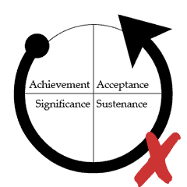
Cycle of works

Slide 6
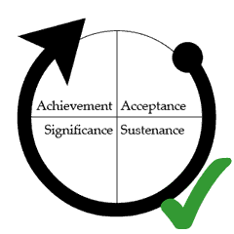
Cycle of grace

Slide 7
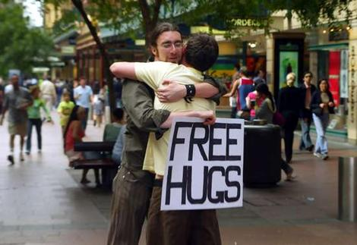
Creating a culture of blessing
“Conspiracy of Kindness” Steve Sjogren
Free Hugs / I’m sorry

Slide 8
Building faith and courage through our stories
Week by week sharing good news stories of lives blessed
Stories of healings, “miraculous” provision for families, people being rescued from debt
People start coming to church because ”if this is what Christianity is about then I want to find out more”
Opportunities to serve and bless open up - the ARC – come and help!

Slide 9
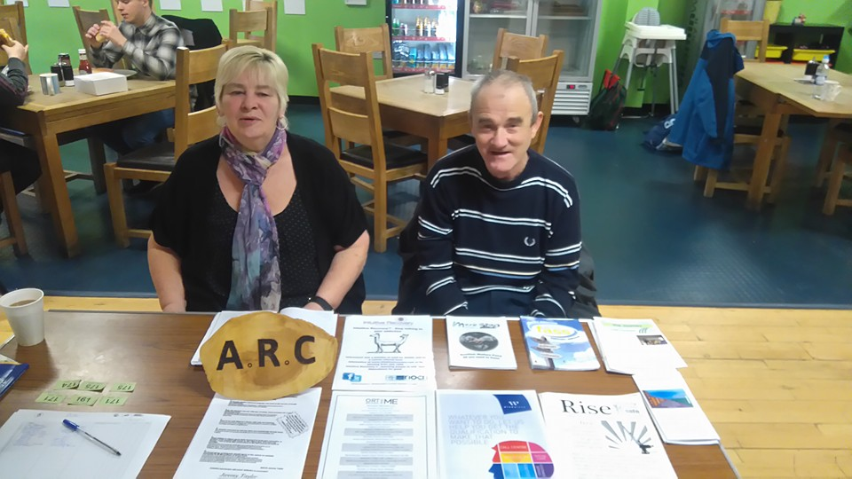
Aftercare Recovery Community (ARC)

Slide 10
Life to the full

Slide 11
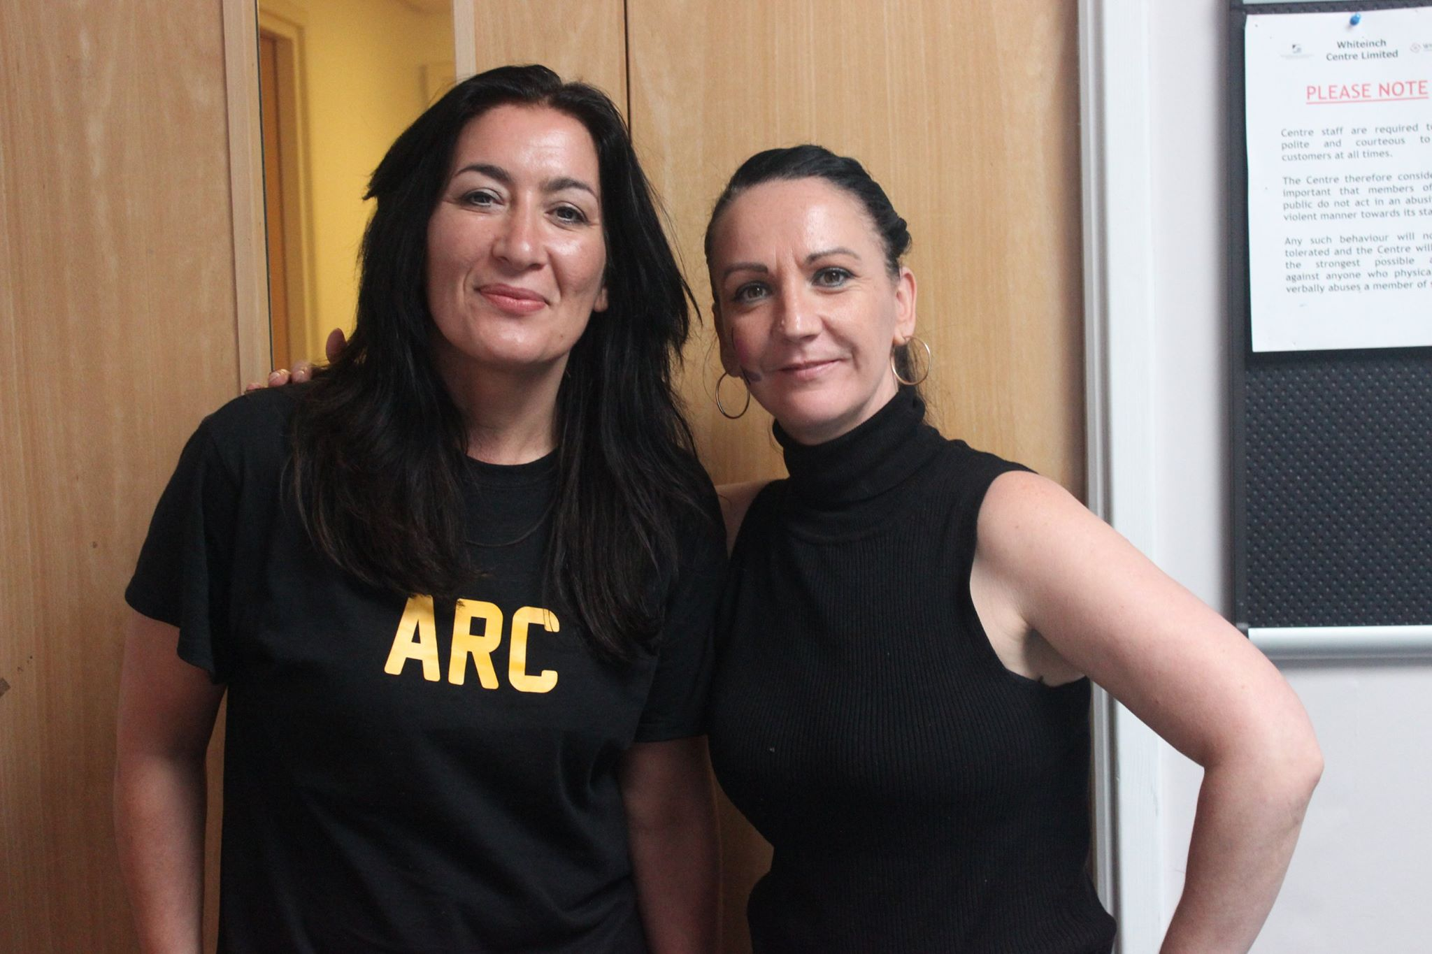
Step 12
“Having had a spiritual awakening as a result of these steps, we try to carry this message to others, and to practice these principles in all our affairs.”

Slide 12
Lessons learned
Sustainable ministry must be the overflow of the love of God in my life
I have needed to model vulnerability and commitment to sharing the love of God to others
Sometimes I have to push passed my natural gifting to serve and connect
I have had to continually carve out time in my diary each week to be amongst those who are journeying towards Jesus
Building a culture of encouragement through telling our story is essential
The fields are white unto harvest – there are loads of folks hungry for Jesus, if not for religion.

Slide 13
Blessed to be a blessing
Alan McWilliam
Whiteinch Church of Scotland, Glasgow
alan@whiteinchchurch.org

