Slide 2
“I am

Slide 3
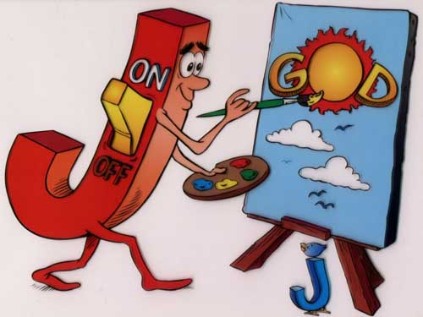
SON
OF
GOD
JOHN

Slide 4
John.20:30-31
The Purpose of This Book
Now Jesus did many other signs in the presence of the disciples, which are not written in this book; but these are written so that you may believe that Jesus is the Christ, the Son of God, and that by believing you may have life in his name.

Slide 5
I am
Before Abram – I Am
I Am the Bread
I am the Light
Iam the Door
I am the Good Shepherd

Slide 6
Jn.11:25

Slide 7
title for a picture
writing to do with this picture i hope

