Slide 1
Jude 17-25

Slide 2
Be on guard against false teaching
Be watchful for teaching which contradicts Scripture
Be watchful for things which contradict our uniquely Christian beliefs about Jesus
Maintain personal integrity

Slide 3
‘A church experiences revival when a large number of people get red-hot about trusting Christ, and red-hot about turning to God for help, and red hot about loving others, especially the lost, and red-hot about showing the glory of God.’ – John Piper

Slide 4
Don’t be surprised by false teaching
False teaching is dangerous because:
False teachers follow natural desires and don’t have the Spirit (Romans 8)
Causes division (John 17:20-25, Ephesians)

Slide 5
v1 - To those who have been called, who are loved in God the Father and kept for Jesus Christ
v24 - To him who is able to keep you from stumbling…

Slide 6
‘Justification admits of no growth or increase: a man is as much justified the hour he first comes to Christ by faith as he will be for all eternity.’ – J.C. Ryle

Slide 7
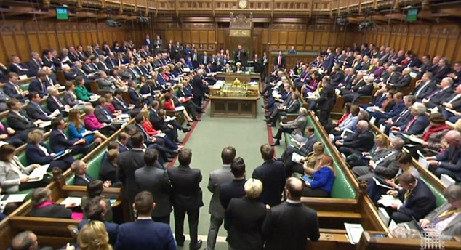

Slide 8
We are called to active faith – keep yourself in God’s love.
Hebrews 12:1-3
2 Timothy 4:8
Just because we can do nothing without Christ doesn’t mean we should do nothing with Christ

Slide 9
Building yourself up in your holy faith (v20)
Praying in the Spirit (v20)
Waiting for the mercy of the Lord Jesus (v21)
Urgent evangelism (v23)

Slide 10
Doxology (= glory, saying)
‘Great joy’ = agalliasis = wild joy, ecstatic delight
Fix your eyes on this

Slide 11
‘A church experiences revival when a large number of people…
get red-hot about trusting Christ | Build yourselves up in your most holy faith
and red-hot about turning to God for help | Pray in the Spirit
and red hot about loving others, especially the lost | Snatch others from the fire
and red-hot about showing the glory of God.’ | Fix your eyes on his glory

