Slide 1
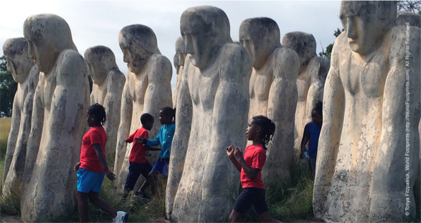
that all may be free
Romans 8:12-27

Slide 2
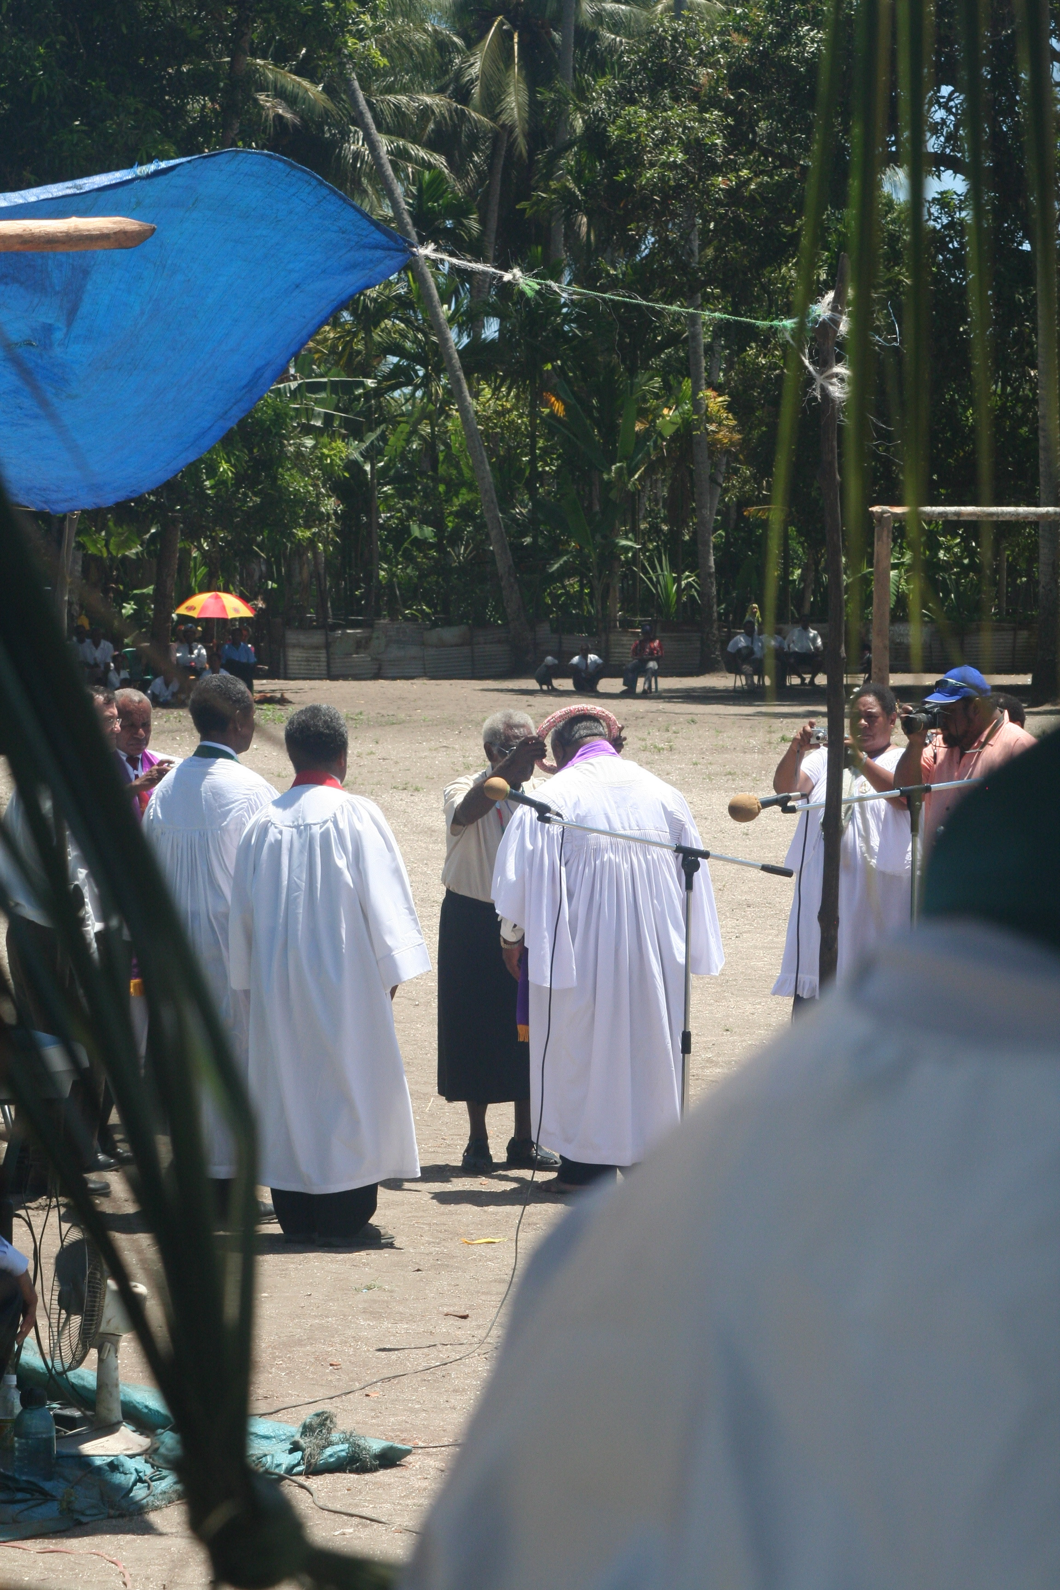

Slide 3
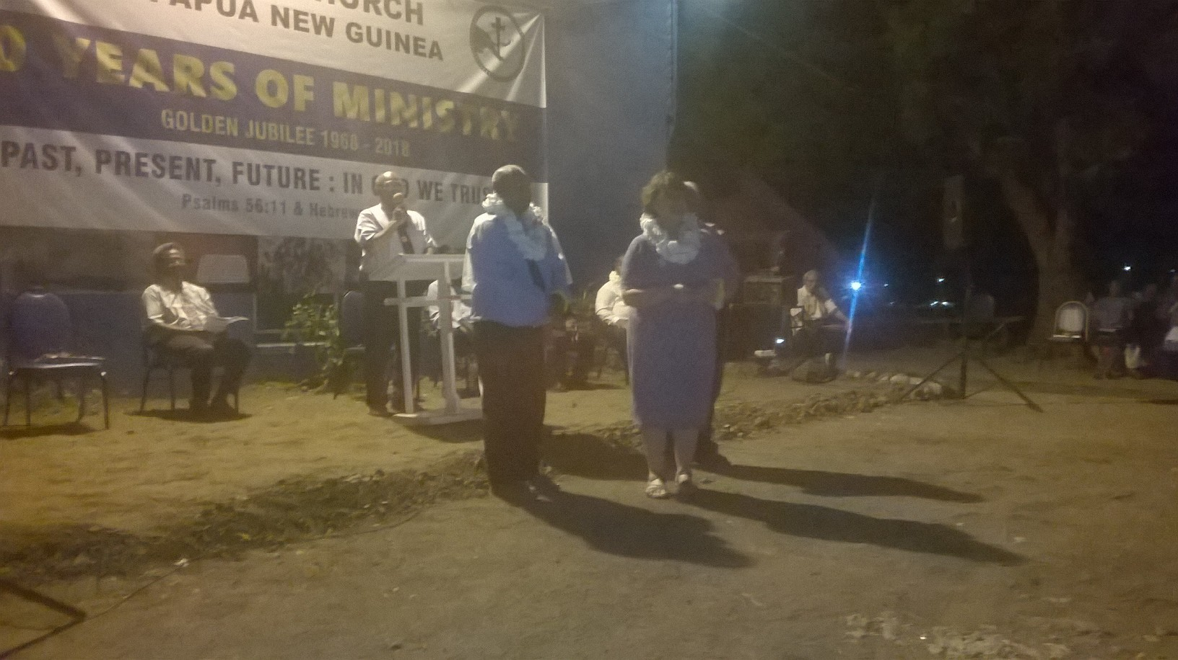

Slide 5
that all may be free

Slide 6
If we are not free
there cannot be justice
If there isn’t justice,
our mission as
God’s people is impeded

Slide 7
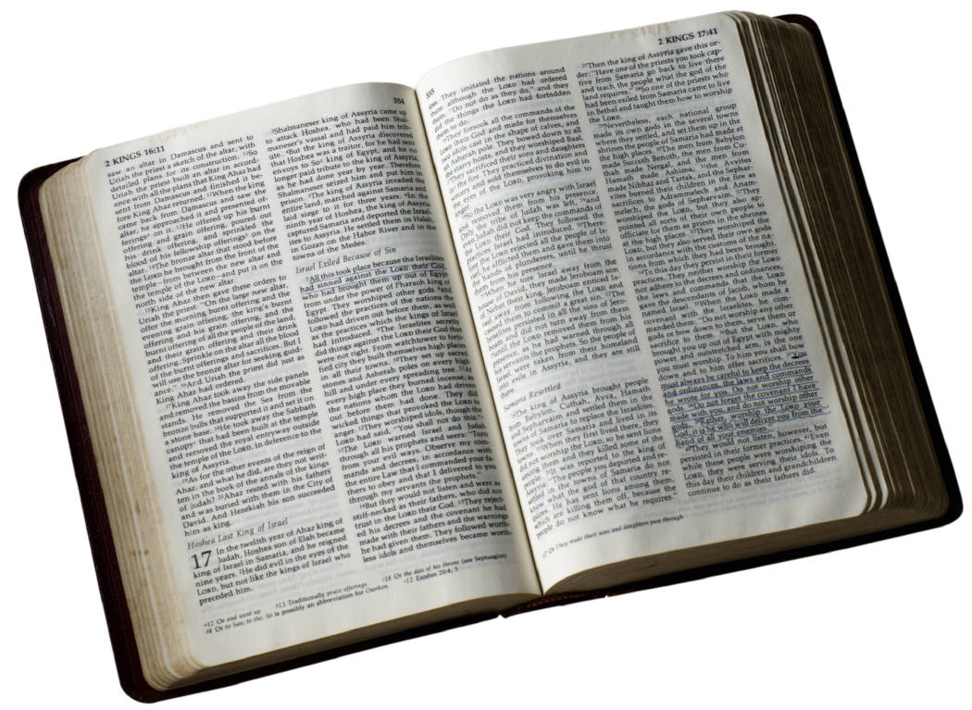

Slide 8
Are we free ourselves?
v12-17
Are we free with each other?
v18-21
Are we inviting others to be free?
v22-25

Slide 9
Are we free ourselves?

Slide 10
Are we free with each other?

Slide 11
Are we inviting others to be free?

Slide 12
Working together to make Jesus known in the Hexham area and beyond

Slide 13
Are we free ourselves?
Are we free with each other?
Are we inviting others to be free?

