Slide 1
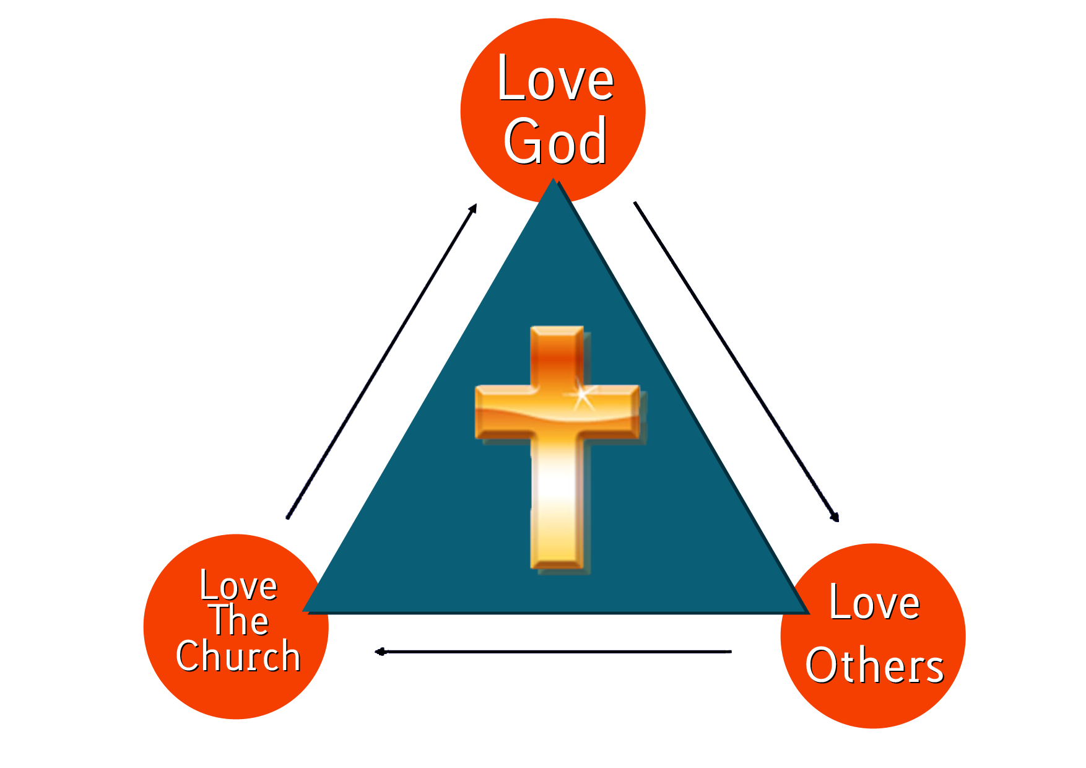
Hexham Community Church

Slide 2
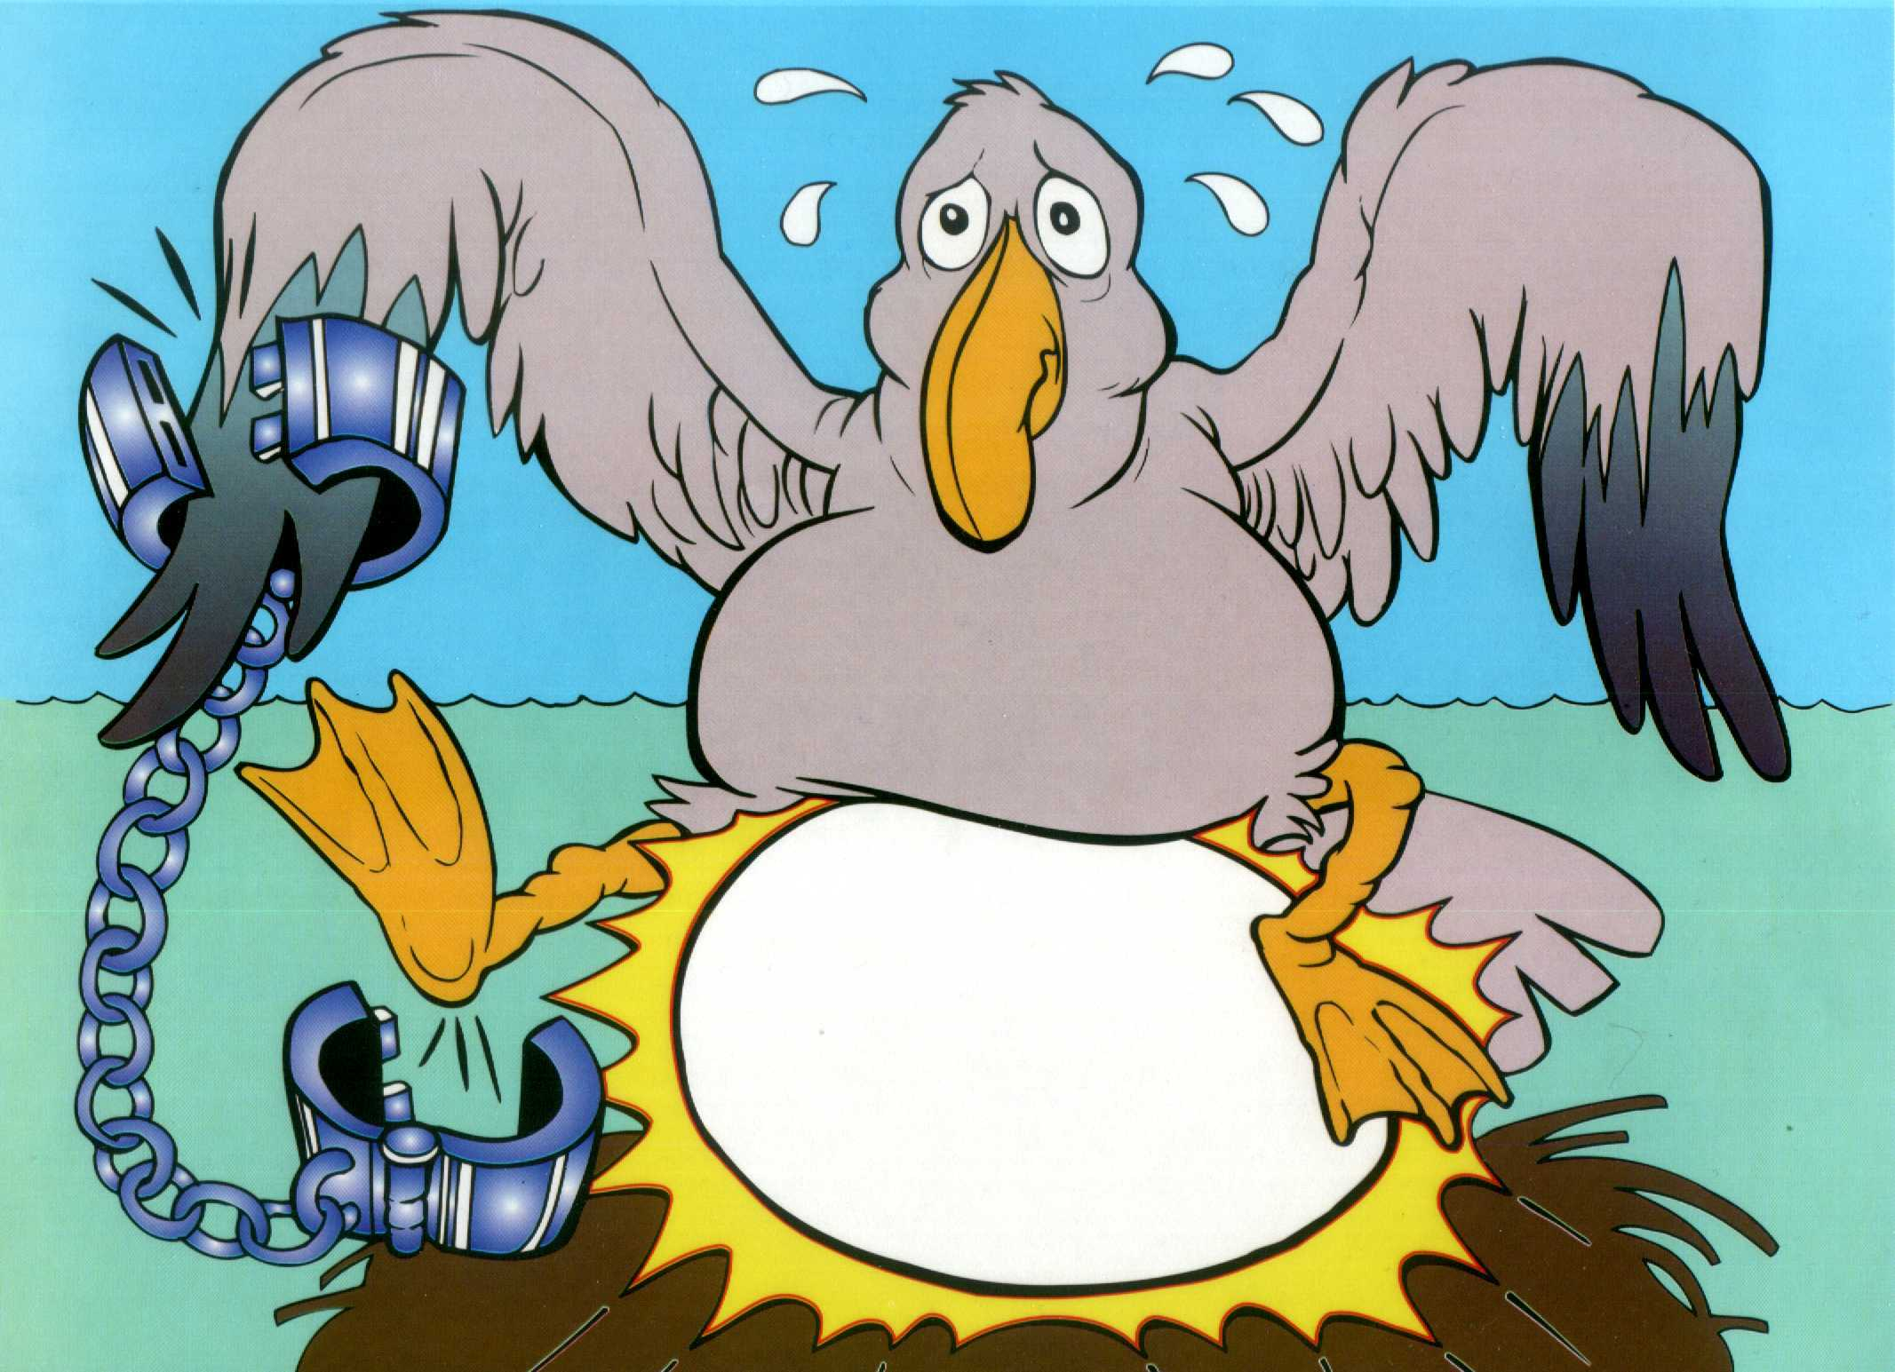

Slide 3
Galations
This picture of an unshackled gull laying a shining egg will stick in your mind forever. “Gull Lay Shine” will remind you of the book of Galatians and the heavy chain falling off our friendly gull will reminded you that the Keyword of Galatians is Unshackled.

Slide 4
Galations
The fine line between the obligation to obey the Law of God and the freedom to obey Him is at the heart of this letter of Paul. It is the basic distinction between the Old and New Covenants of God with man. Does man have to satisfy God’s law to be forgiven, or once forgiven, i.e., Unshackled from the rigidity of the Law, does man have power and freedom in the Spirit to please God?

Slide 5
Galations
To the Galatians, Paul re-establishes the primacy of life in the Spirit. The Judaizers, whose teachings placed believers back into slavery to the Law, are rebuked, and the Galatians are exhorted to walk in the Spirit rather than the lust of the flesh.

