Slide 1
HOW TO PRAY
THROUGHOUT THE DAY
Notes:
Intimidating thought!

Slide 2
What information would you share with…
An acquaintance?
Your neighbour?
Your boss?
A work colleague?
A friend?
A family member?
A best friend?
A spouse?
Notes:
authority
engagement
commitment
vulnerability
accountability

Slide 3

Switch on

Slide 4
“¹⁶ Rejoice always, ¹⁷ pray without ceasing, ¹⁸ give thanks in all circumstances; for this is God’s will for you in Christ Jesus.
1 Thessalonians 5:16-18 (ESV)
Notes:
not a “single moment” thing
individuals & corporately

Slide 5
Pray without ceasing
The Greek is ‘adialeiptos’ which means ‘constantly recurring.’ In other words, we can punctuate our moments with intervals of recurring prayer.
Another way of interpreting it is through the words ‘without omission.’
Further still:
‘indistinguishable’
‘whole-heartedly.’
Notes:
without ceasing = like a hacking cough; often & repeatedly
without omission – nothing too large/small/off topic/taboo with God
indistinguishable – not different or distinct from “normal life”

Slide 6

Your relationship
Where is God in your life?
What kind of relationship do you have with Him?
Notes:
how involved do you let Him be in your day to day?
we all have priority relationships in our lives

Slide 7

Notes:
no divide in secular & spiritual
how do you relate to this quote?
where do you connect? in the car – GMA registration LORRY
in the car - lesson plans
* naturally supernatural

Slide 8

Intimacy
Notes:
How do you get to know someone?
hang out with them
show an interest
seek opportunities to connect
Bible – see how Jesus prayed & when:
at baptism
prior to selecting the Twelve
after rejection
hinge moment of recognition
moment of revelation
time of deep need in others
last supper
Gethsemane
on the cross

Slide 9
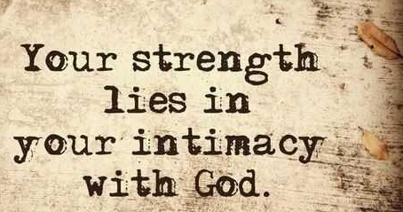
Notes:
Paul Miller: A praying life “Know that you can’t do life on your own”
*recognise need to depend on God in every situation
*prayer is the language of trusting in the Lord
SHARING THE GOOD NEWS
How can you talk to others about God if you are not prepared to spend time in prayer talking to God about others

Slide 10
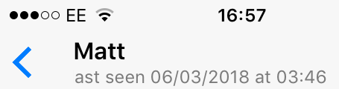
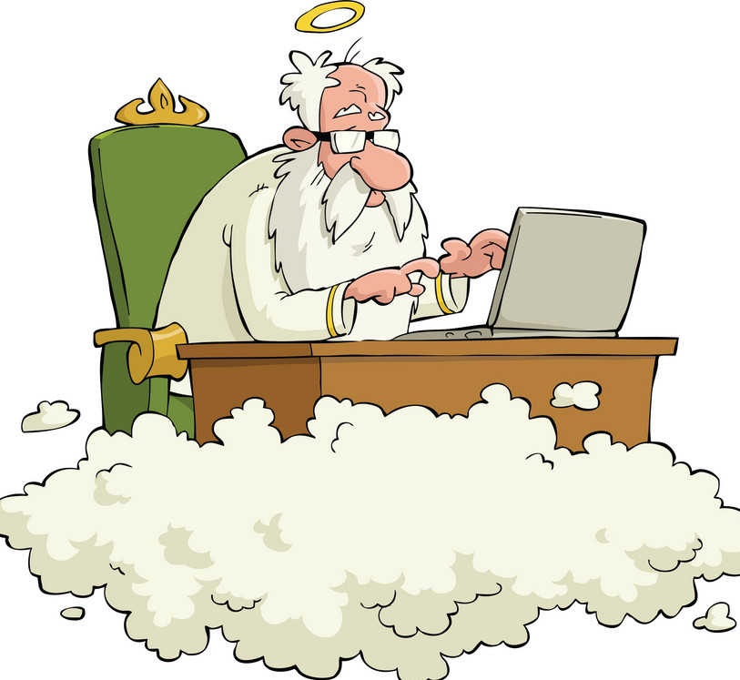
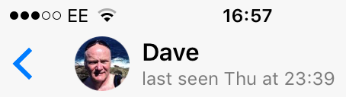
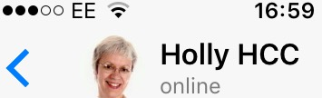
Prayer: constant communication
Notes:
Whatsapp
time & date stamp for last used
difference between last time connecting with you
ONLINE Typing …

Slide 11
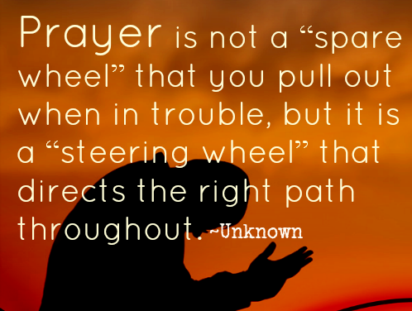
Notes:
position of significance that God has in your life
direction & purposeful
relational connection
who better to be in touch with than the author of our lives – creator who made us
not monologue but dialogue
Are you prepared to listen & give Him an opportunity to speak into your life and direct everything in your life “without omission?”

Slide 12
“¹⁸ And pray in the Spirit on all occasions with all kinds of prayers and requests. With this in mind, be alert and always keep on praying for all the Lord’s people.”
Ephesians 6 v 18 (NIV)

Slide 13
Dependence on god
Does a spirit of dependence permeate all we do?
Even when we are not speaking consciously to God, is there is a deep, abiding dependence on Him that is woven into the very essence of our faith?

Slide 14
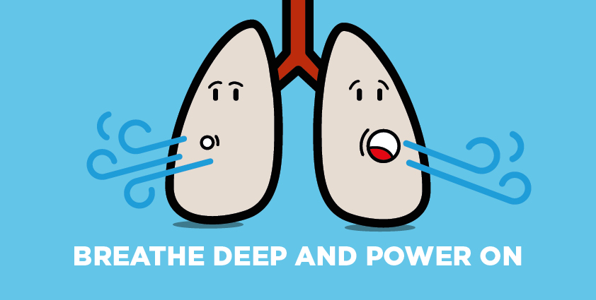
Prayer as natural as breathing
Notes:
PAUSE – focus on breathing
natural event – no thought
when do we notice our breathing?
sick – when prayer is hard?
heavy breathing / exercise – deliberately engaging in prayer – hard times?

Slide 15
“If we think of prayer as the breath of our lungs and the blood from our hearts, we think rightly. The blood flows and the breathing continues – we are not conscious of it but it is always going on.”
Oswald Chambers

Slide 16
“To be a Christian without prayer is no more possible than to be alive without breathing.”
Martin Luther King Jr

Slide 17
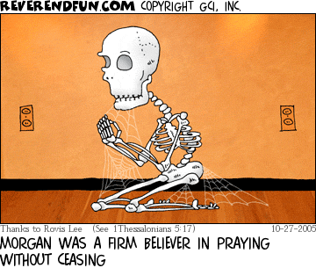
Prayer isn’t a posture of the body
Notes:
it’s about the position of your heart
are you desiring a greater level of interaction with God?
- deeper sense of authenticity
- engagement and revelation
- focussed commitment
- transparent vulnerability
- responsive accountability

Slide 18
HOLLY’s SECTION!

Slide 19


HOW DO I PRAY ALL DAY?
What doesn’t help?
Obligation Guilt Trying harder
Notes:
In the series we have mentioned the Lord’s prayer – not a formula
Obligation - Christmas letter; Uni phone calls
timed slots – one thing having a “date” with God but quite another saying “I must pray for 20mins” – imagine that approach in natural relationships
alarms & lists – may be helpful to an extent to help you set a pattern but not if they become meaningless rote
Guilt
Trying harder

Slide 20
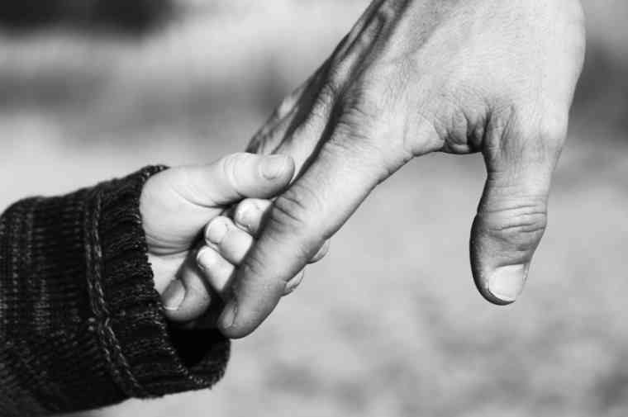
Holding father’s hand
Notes:
Knowing I’m a loved child, protected, provided for, cherished

Slide 21
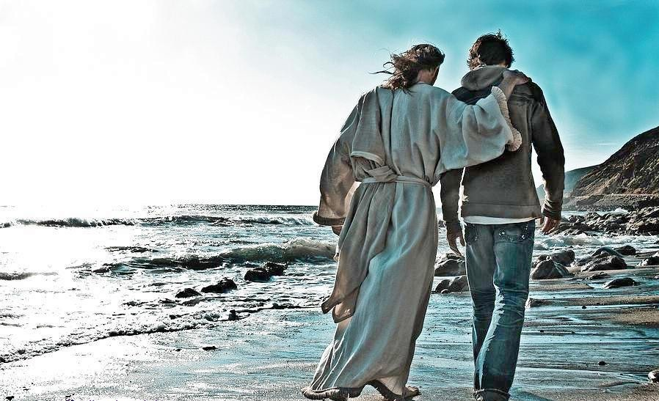
Walking with jesus
Notes:
Never alone, listening to the Shepherd’s voice

Slide 22
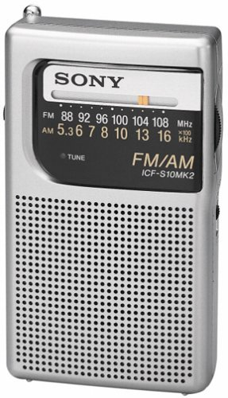
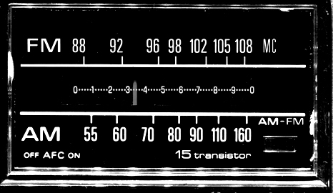
in tune with holy spirit
Notes:
He is the one who connects us through Jesus and what He did for us to the Father.
Without Him this is religion, not relationship. *do you want to be filled?
Without Him, this is like pushing that boulder up the hill
He is Enabler, Comforter, Guide, Teacher – how to pray and what to pray

Slide 23
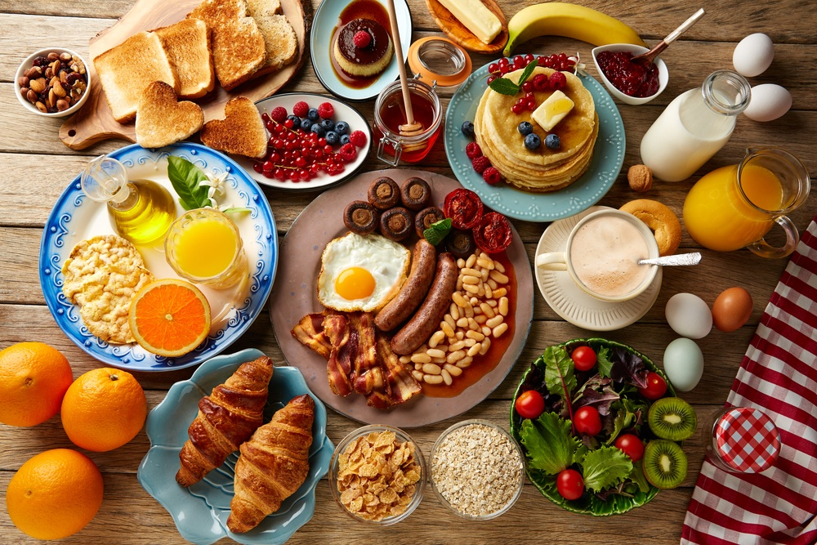
START THE DAY WELL
Enter his gates with thanksgiving and his courts with praise; give thanks to him and praise his name. Psalm 100:4
Notes:
Breakfast with Jesus - “date” – smorgasboard breakfast
How do you start your day? Psalm 100:4 praise & thanksgiving set the tone; set the atmosphere for the day. Enter his presence – stay there!!
Daniel & Jesus – combination of planned prayer times & more spontaneous moments where they responded to what was going on by inviting God into the situation
communication – bible – what is He saying to you at the start of the day – mull over the conversation – chew on it throughout the day
prayer, praise, worship & bible all inextricably linked – banquet continues

Slide 24
IN HIS PRESENCE
“I do nothing else but abide in His presence and I do this by simple attentiveness and an habitual loving turning of my eyes upon Him.”
Brother Lawrence:
“The Practice of the Presence of God”
Notes:
Brother Lawrence 17th century monk
Mercy & grace to help Hebrews 4:6 Goodness, satisfaction & holiness Psalm 65: 4 times of refreshing Acts 3:20-21
Strength & safety Psalm 46:1 fullness of joy Psalm 16:11 rest Exodus 33:11
Mountains tremble Isaiah 64:1-3
what mountains do you need to make tremble in your life? sickness, despair, fear, hopelessness, doubt, debt, addiction, sin

Slide 25

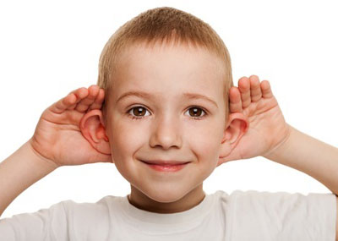




KEEP THE CHANNEL OPEN
Notes:
No particular order – smorgasboard continues all day
asking questions & expecting answers about anything and anything; writing what I think he is saying
silence learning to sit quietly; soaking
worship choosing to worship first
fasting to increase hunger for God
variation like any relationship – same old same old can get stale, especially if you are using the same prayers – life, creativity
tongues for when I run out things to say; singing in tongues a lot – keeps the connection
awareness of dependence things that I can’t change, that are too big for me, need for wisdom
practising hearing His voice TSSM, SOL, asking a question & just writing the answer, Sch of B&M courses
chuntering “chatting with God” increases awareness of His presence

Slide 26
SO WHAT STOPS ME?
Relationship
Barriers
Wrong beliefs
Expectations
Distraction
Clutter
Notes:
Relationship is key ** do you have one
Continuous prayer is a natural RESULT of an intimate relationship – not something you strive for
PRAY at each point, asking God to show them if there is anything
Lack of relationship
ask Jesus to make Himself more real to you
ask Him to show you anything that hinders your relationship
Barriers unforgiveness sin doubt / fear -leading to control - lack of surrender – FG is there anything you are not happy about in my life? FG is there anyone I need to forgive?
Wrong beliefs about God, yourself, prayer
Expectations will He speak to you? answer you? hear you?
Distraction
who is distracting you I wonder!
counteracting boredom thoughts that come negativity fleshly distractions – enlist God’s help!
Clutter - white noise, busyness, stuff of life – retune the dial

