Slide 1
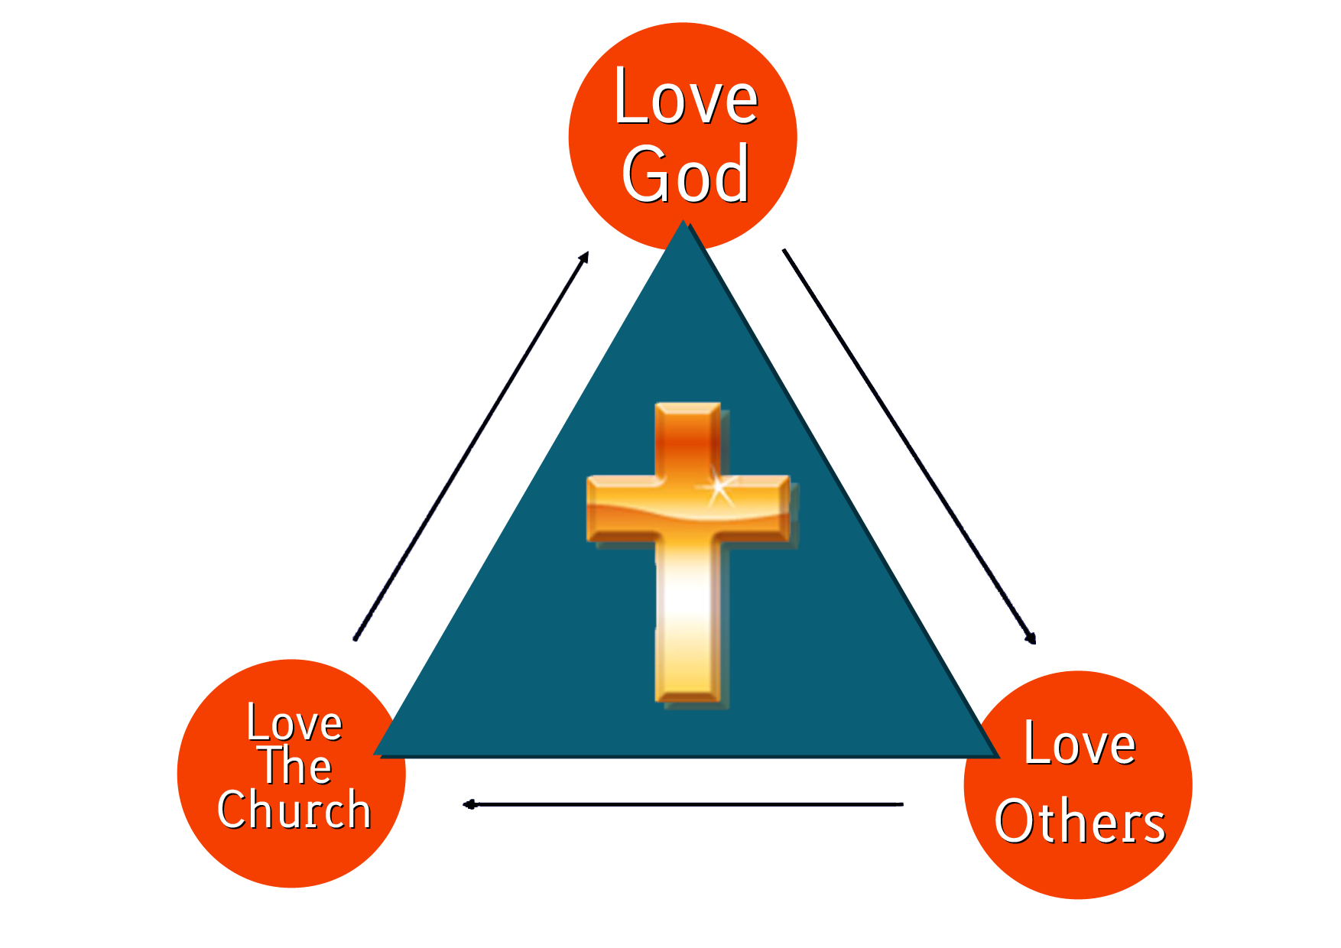
Hexham Community Church
Easter Sunday
Was the Tomb Empty?

Slide 2
Jesus told them!
Matthew 20:17-19 NIV
17 Now Jesus was going up to Jerusalem. On the way, he took the Twelve aside and said to them,
18 “We are going up to Jerusalem, and the Son of Man will be delivered over to the chief priests and the teachers of the law. They will condemn him to death
19 and will hand him over to the Gentiles to be mocked and flogged and crucified. On the third day he will be raised to life!”

Slide 3
Was the Tomb empty? Theological Debate
Location
Passing Down
Women

Slide 4
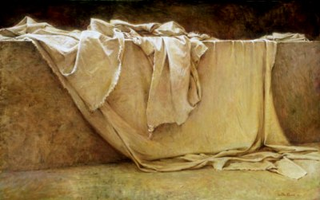
The clever answer!
Angels
Shroud

Slide 5
This mornings answer
The Hope of the Resurrection
¹³ And now, dear brothers and sisters, we want you to know what will happen to the believers who have died^{[a]} so you will not grieve like people who have no hope. ¹⁴ For since we believe that Jesus died and was raised to life again, we also believe that when Jesus returns, God will bring back with him the believers who have died.
¹⁵ We tell you this directly from the Lord: We who are still living when the Lord returns will not meet him ahead of those who have died.^{[b]} ¹⁶ For the Lord himself will come down from heaven with a commanding shout, with the voice of the archangel, and with the trumpet call of God. First, the believers who have died^{[c]} will rise from their graves. ¹⁷ Then, together with them, we who are still alive and remain on the earth will be caught up in the clouds to meet the Lord in the air. Then we will be with the Lord forever. ¹⁸ So encourage each other with these words.

Slide 6
The tomb for me:
Was full of
Hope

